Slide 1
SEGY eShopper
611145 | Gebrehiywet Fissaha | Tsehaye
110995 | Eden Teclemariam | Zere
611098 | Simon Abraham | Weldemichael
110930 | Yohannes Baye | Mulualem

Slide 2
Introduction
SEGY shopping center has many branches and it has many customers
It’s not possible to handle costumers need manually
The numbers of customers are increasing
Corona virus pandemic and it is not possible to help all customers in the store
Emerging trend of e-commercial
The new system will be a web-based application which will have different stockholders such as the administrator, sellers and buyers

Slide 3
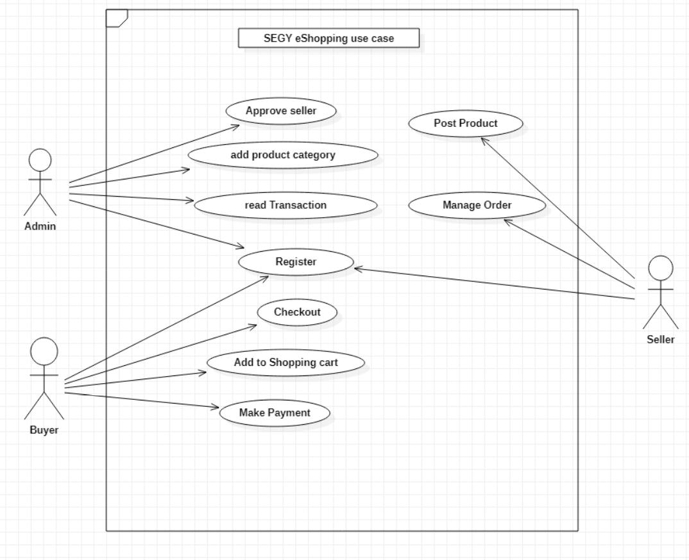
Use Case Diagram

Slide 4
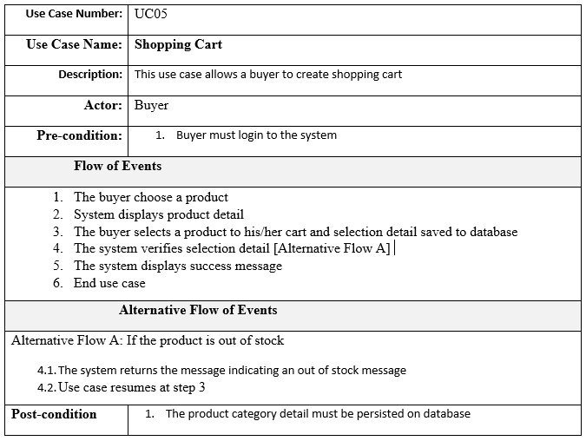
Use case Description

Slide 5
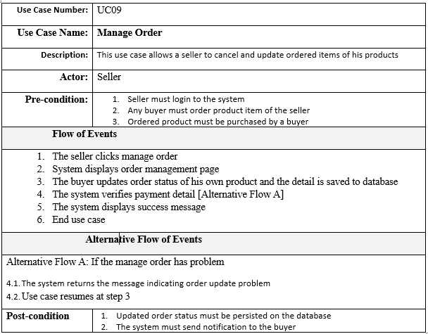
Cont’d

Slide 6
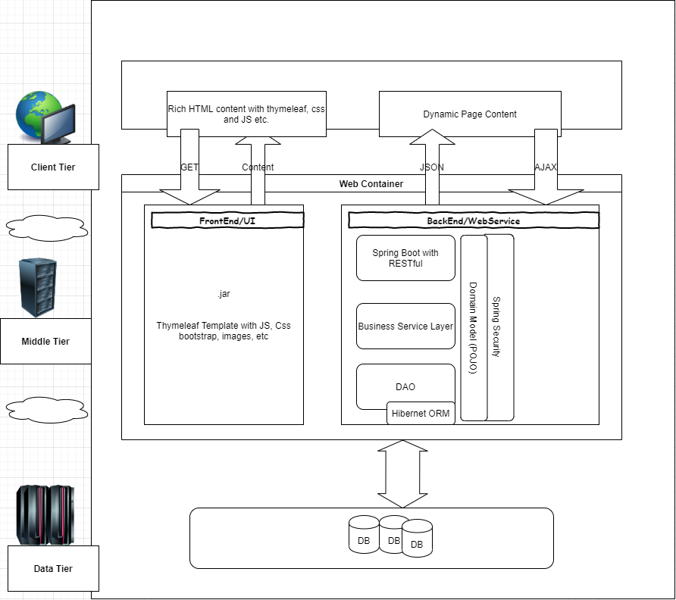
System Architecture Diagram

Slide 7
Key Abstractions
Login
Registration
Role
ProductCategory
Product
Checkout
ShoppingCart
Payment
Order

Slide 8
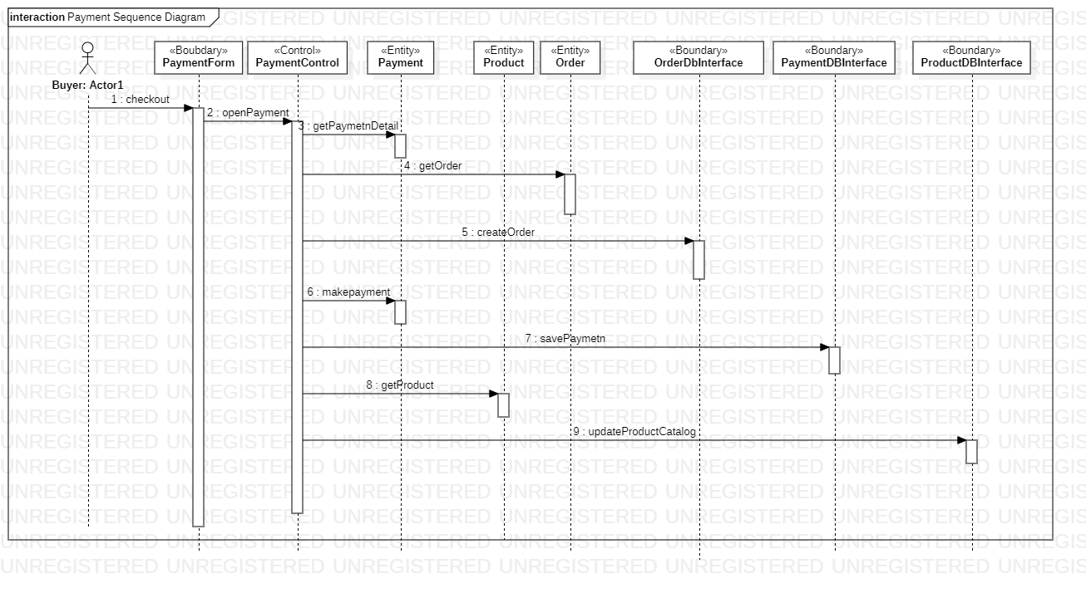
Sequence Diagrams

Slide 9
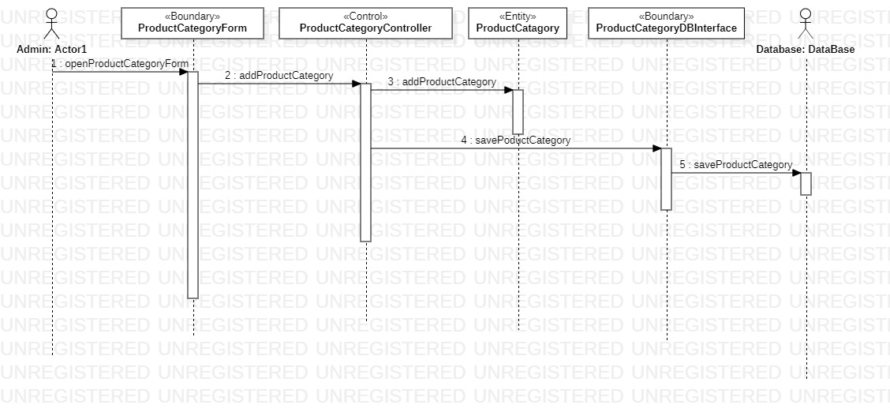
Cont’d

Slide 10
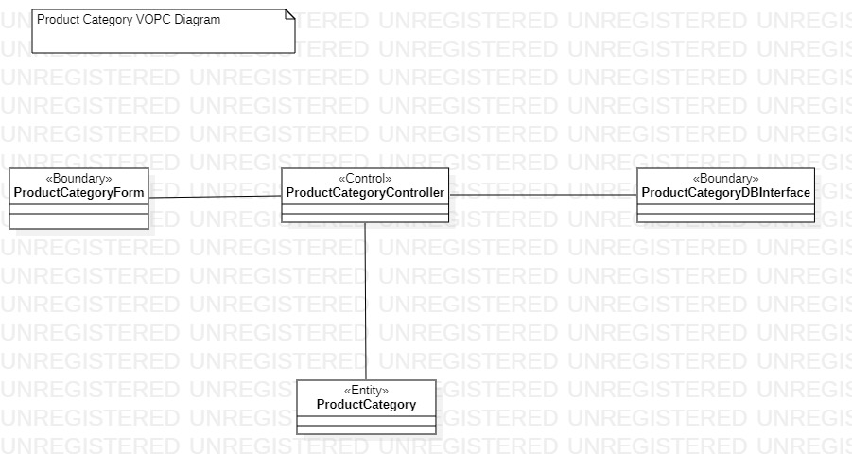
Class Diagram
Product Category Class Diagram

Slide 11
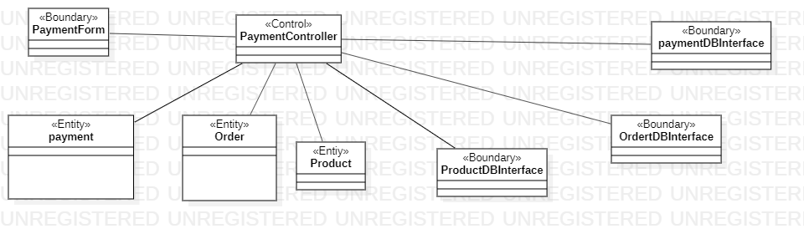
Cont’d
Payment Class Diagram

